Slide 1


Relationships and Causality
10
PART II · FROM DATA TO INSIGHT
CHAPTER 10 · WEEK 6
Data Science — From Foundations to Intelligent Systems
LECTURER
Dr. Mustafa Hameed
THE ISLAMIA UNIVERSITY OF BAHAWALPUR
Bahawalpur, Pakistan
Department of Information Technology · BSIT · Fall 2026
Notes:
Chapter 10: Relationships and Causality. Part 2 — From Data to Insight. Week 6: Inference and causality. Handout pages 62–69.

Slide 2

Where this chapter sits
THE COURSE
PART I
PART II
PART III
PART IV
PART V
PART VI
1
2
3
4
5
6
7
8
9
10
11
12
13
14
15
16
17
18
19
20
21
22
23
24
25
26
27
28
29
30
31
32
Relationships and Causality
BUILDS ON
USED LATER IN
Ch 8 Exploratory Data Analysis and Visualisation
Ch 28 Responsible AI and Data Ethics
Ch 9 Inferential Statistics
Ch 29 Research Methods and Experimental Design
Data Science · Chapter 10 · Relationships and Causality
Handout p. 62 2
Notes:
Place the chapter. Before you start: Chapter 8 (Simpson’s paradox, which is confounding seen in a chart) and Chapter 9 (hypothesis testing, effect size, power).

Slide 3

What you will be able to do
LEARNING OUTCOMES
By the end of this chapter you will be able to:
1
Explain why correlation does not imply causation, and name the four alternative explanations for any observed association.
2
Identify confounders, colliders and mediators in a described scenario.
3
Design a randomised controlled experiment (A/B test) with a defensible sample size.
4
Select an appropriate quasi-experimental design when randomisation is impossible.
5
Distinguish the questions prediction can answer from those that require causal inference.
Data Science · Chapter 10 · Relationships and Causality
Handout p. 62 3
Notes:
Read these out: they are the chapter's contract with the room. Each click adds one.

Slide 4

Vocabulary for this chapter
KEY TERMS
causation
confounder
collider
mediator
reverse causation
spurious correlation
randomised controlled trial
A/B test
control group
counterfactual
natural experiment
difference-in-differences
selection bias
Each term is defined where it first matters — not here.
Data Science · Chapter 10 · Relationships and Causality
Handout p. 62 4
Notes:
Do not define these now; they arrive one at a time. This slide is for the students' notes. Terms: causation; confounder; collider; mediator; reverse causation; spurious correlation; randomised controlled trial; A/B test; control group; counterfactual; natural experiment; difference-in-differences; selection bias.

Slide 5
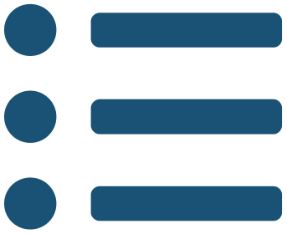
In this chapter
IN THIS CHAPTER
10.1
The Four Explanations for Any Correlation
p. 62 ›
10.2
Confounders, Colliders and Mediators
p. 63 ›
10.3
Experiments: The Gold Standard
p. 63 ›
10.4
When You Cannot Randomise
p. 64 ›
10.5
Prediction Does Not Need Causation — Until It Does
p. 65 ›
Data Science · Chapter 10 · Relationships and Causality
Handout pp. 62–69 5
Notes:
The route through the chapter. Each row is a link: click it to jump to that section in the slide show.

Slide 6
The Four Explanations for Any Correlation
SECTION 1 OF 5
10.1
10.1 The Four Explanations for Any Correlation
10.2 Confounders, Colliders and Mediators
10.3 Experiments: The Gold Standard
10.4 When You Cannot Randomise
10.5 Prediction Does Not Need Causation — Until It Does
Data Science · Chapter 10
Handout §10.1 6
Notes:
Pause. Name the question this section answers.

Slide 7
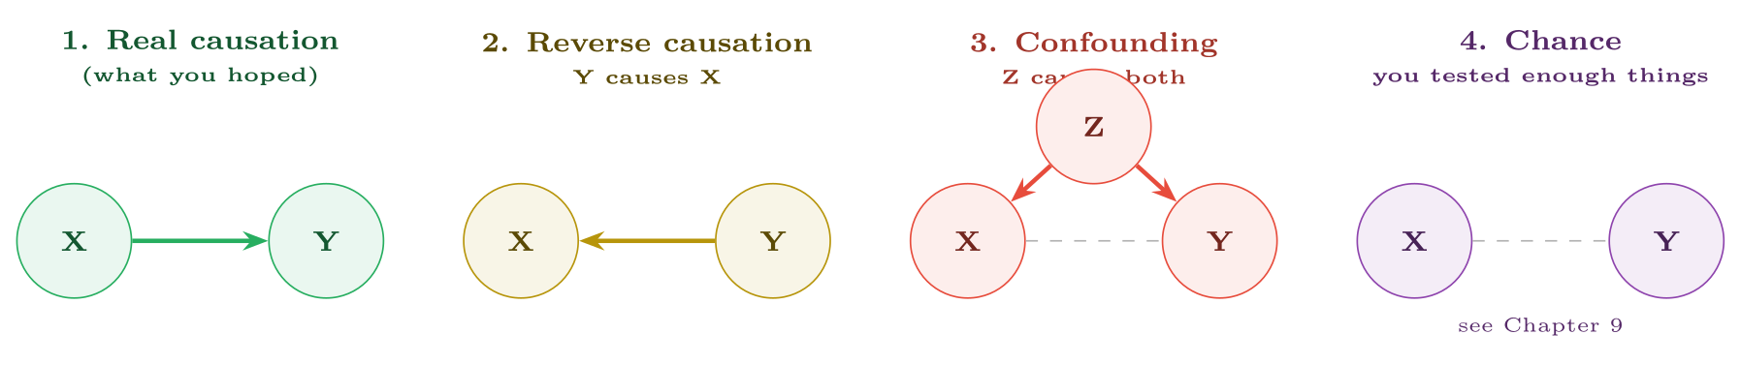
The four explanations for an observed association
FIGURE 10.1
Data alone cannot distinguish them — the same correlation coefficient is consistent with all four. Only a design can.
Data Science · Chapter 10 · Relationships and Causality
§10.1 · Handout p. 62 7
Notes:
You observe that students who attend the optional revision session score higher. Before concluding the session helps, note that there are four possible explanations, and only one of them is the one you want.
Figure 10.1 (handout p. 62): The four explanations for an observed association. Data alone cannot distinguish them — the same correlation coefficient is consistent with all four. Only a design can.

Slide 8

Applying the Four to One Finding
WORKED EXAMPLE
“Students who attend revision sessions score 12 marks higher.”
1. Causation. The session teaches them things. Plausible.
2. Reverse causation. Students already doing well feel they can spare an evening; struggling students are behind on coursework and cannot. Also plausible, and it predicts the same correlation.
3. Confounding. Conscientiousness causes both attendance at optional sessions and higher marks. The session may contribute nothing. Highly plausible — and it is the default explanation for almost every “optional activity helps” finding in education.
4. Chance. If the department examined 30 optional activities, one showing a 12-mark gap is unremarkable.
The 12 marks is not wrong; the interpretation is unsupported. If the department cancels the session on the strength of a null finding, or expands it on the strength of this one, both decisions rest on nothing. What settles it is assignment: decide who attends by a mechanism unrelated to the student.
Data Science · Chapter 10 · Relationships and Causality
§10.1 · Handout p. 62 8
Notes:
Each click adds one step of the working. Ask for the next number before you reveal it.

Slide 9
Confounders, Colliders and Mediators
SECTION 2 OF 5
10.2
10.1 The Four Explanations for Any Correlation
10.2 Confounders, Colliders and Mediators
10.3 Experiments: The Gold Standard
10.4 When You Cannot Randomise
10.5 Prediction Does Not Need Causation — Until It Does
Data Science · Chapter 10
Handout §10.2 9
Notes:
Pause. Name the question this section answers.

Slide 10
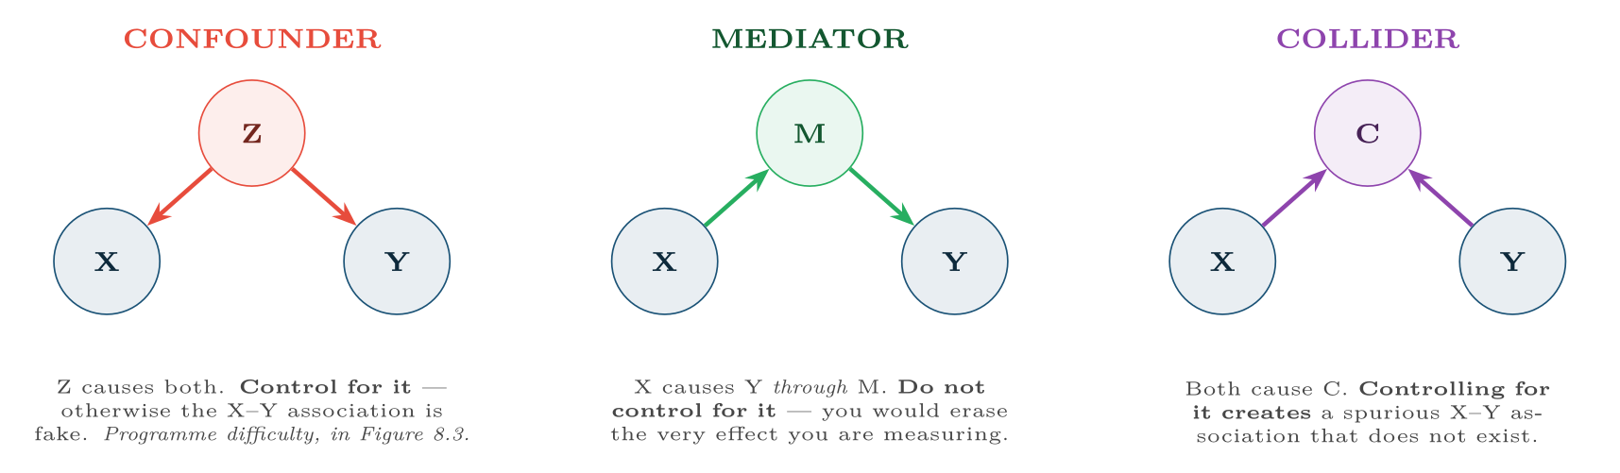
Three roles for a third variable
FIGURE 10.2
“Control for everything you have” is not a safe default: adjusting for a mediator hides a real effect, and adjusting for a collider manufactures a false one.
Data Science · Chapter 10 · Relationships and Causality
§10.2 · Handout p. 63 10
Notes:
Three different roles a third variable can play. They look similar in a dataset and demand opposite treatment, which is why they are worth separating carefully.
Figure 10.2 (handout p. 63): Three roles for a third variable. “Control for everything you have” is not a safe default: adjusting for a mediator hides a real effect, and adjusting for a collider manufactures a false one.

Slide 11

A Collider You Will Meet
CONCEPT
Suppose both technical skill and interview preparation independently increase the chance of being hired. Among hired employees, the two become negatively correlated — someone who got in with little preparation must have been very skilled. Studying only hired staff, you would “discover” that preparation harms skill. Selecting on the outcome (hiring) is conditioning on a collider, and it is the mechanism behind a great deal of survivorship bias.
Data Science · Chapter 10 · Relationships and Causality
§10.2 · Handout p. 63 11
Notes:
Read the box aloud, then ask for an example from the room before moving on.

Slide 12
Experiments: The Gold Standard
SECTION 3 OF 5
10.3
10.1 The Four Explanations for Any Correlation
10.2 Confounders, Colliders and Mediators
10.3 Experiments: The Gold Standard
10.4 When You Cannot Randomise
10.5 Prediction Does Not Need Causation — Until It Does
Data Science · Chapter 10
Handout §10.3 12
Notes:
Pause. Name the question this section answers.

Slide 13

Randomised Controlled Trial
DEFINITION
Units are assigned to treatment or control at random. Randomisation makes the two groups equivalent in expectation on every variable — measured, unmeasured and unimagined — so any difference in outcome can be attributed to the treatment.
Data Science · Chapter 10 · Relationships and Causality
§10.3 · Handout p. 63 13
Notes:
Read the box aloud, then ask for an example from the room before moving on.

Slide 14
Why Randomisation Is So Powerful
CONCEPT
Statistical control can only adjust for confounders you thought of and measured. Randomisation handles the ones you never knew existed. That is the whole argument, and it is why one small randomised study can outweigh a large observational one.
Data Science · Chapter 10 · Relationships and Causality
§10.3 · Handout p. 63 14
Notes:
Read the box aloud, then ask for an example from the room before moving on.

Slide 15
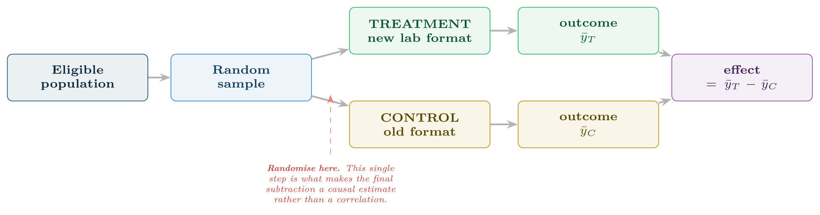
The structure of a randomised experiment
FIGURE 10.3
Everything hinges on the random assignment step: without it, the final difference confounds the treatment with whatever made people end up in each group.
Data Science · Chapter 10 · Relationships and Causality
§10.3 · Handout p. 63 15
Notes:
Figure 10.3 (handout p. 64): The structure of a randomised experiment. Everything hinges on the random assignment step: without it, the final difference confounds the treatment with whatever made people end up in each group.

Slide 16
How Many Students Do You Need?
WORKED EXAMPLE
You want to detect a 10 percentage-point rise in pass rate (from 68% to 78%) with 80% power at α = 0.05.
For two proportions, a workable approximation is
With p̄ = 0.73 and δ = 0.10:
So 630 students in total — and the worked example in Chapter 9, which had 100 per group, was therefore never capable of detecting this effect. That is why its p = 0.078 told you almost nothing.
Halve the effect you want to detect (δ = 0.05) and n rises to about 1,260 per group: the sample scales with 1/δ². Small effects are extremely expensive to establish, which is worth knowing before promising a stakeholder an answer.
Data Science · Chapter 10 · Relationships and Causality
§10.3.1 · Handout p. 64 16
Notes:
Each click adds one step of the working. Ask for the next number before you reveal it.

Slide 17
When You Cannot Randomise
SECTION 4 OF 5
10.4
10.1 The Four Explanations for Any Correlation
10.2 Confounders, Colliders and Mediators
10.3 Experiments: The Gold Standard
10.4 When You Cannot Randomise
10.5 Prediction Does Not Need Causation — Until It Does
Data Science · Chapter 10
Handout §10.4 17
Notes:
Pause. Name the question this section answers.

Slide 18

When You Cannot Randomise
AT A GLANCE
Design | Idea | Key assumption (state it explicitly)
Before/after | Compare the same units before and after a change | Nothing else changed at the same time — usually false
Difference-in-differences | Compare before/after change in a treated group against an untreated one | The two groups’ trends would have moved in parallel without the treatment
Matching | Pair each treated unit with a similar untreated one | All relevant confounders were measured and used in matching
Regression discontinuity | Compare units just either side of a cutoff (e.g. a 40% pass mark) | Units cannot precisely manipulate which side they land on
Instrumental variable | Use something that shifts treatment but not the outcome directly | The instrument affects the outcome only through the treatment
Data Science · Chapter 10 · Relationships and Causality
§10.4 · Handout p. 64 18
Notes:
Often randomisation is impossible — you cannot randomly assign students to be disadvantaged, or randomly expose half your servers to attack. Quasi-experimental designs recover part of the causal claim.

Slide 19

Before/After Alone Is Not Evidence
WATCH OUT
“We deployed the new firewall rules and incidents fell 40%” is compatible with: the rules worked; attack volume fell for unrelated reasons; the reporting process changed; a seasonal trough. Add a comparison group that did not receive the change and you have difference-in-differences — a genuinely different quality of claim, for very little extra work.
Data Science · Chapter 10 · Relationships and Causality
§10.4 · Handout p. 64 19
Notes:
Read the box aloud, then ask for an example from the room before moving on.

Slide 20
The Distinction That Decides Your Method
CONCEPT
For prediction, correlation is enough. A model that flags at-risk students using forum inactivity works whether or not inactivity causes failure.
For intervention, correlation is useless. Forcing students to post on the forum will not help if inactivity was merely a symptom. The moment anyone asks “so what should we do?”, you have left prediction and entered causal inference — and Parts III and IV, which are entirely about prediction, will not answer it.
Data Science · Chapter 10 · Relationships and Causality
§10.5 · Handout p. 65 20
Notes:
Read the box aloud, then ask for an example from the room before moving on.

Slide 21





Four lenses: Causal Claims
FOUR LENSES
LEARNING ANALYTICS
PROJECT MANAGEMENT
Confounder: prior attainment causes both engagement and final marks, so any “engagement helps” finding must adjust for it.
Confounder: project complexity causes both the choice of methodology and the risk of overrun, so “agile projects succeed more” is almost always confounded — simple projects get agile.
INTERNET OF THINGS
CYBERSECURITY
Confounder: ambient temperature drives both cooling-fan speed and failure rate.
Reverse causation: do more security tools cause fewer incidents, or do organisations that suffer incidents buy more tools?
Data Science · Chapter 10 · Relationships and Causality
Handout p. 69 21
Notes:
The same method, four domains. Each of the next four slides opens one lens in full.

Slide 22

Learning Analytics: Causal Claims
FOUR LENSES
LEARNING ANALYTICS
Project Management
Confounder: prior attainment causes both engagement and final marks, so any “engagement helps” finding must adjust for it. Design: randomise which students are offered the intervention, not who takes it — then compare by offer (intention to treat), which stays causal even though uptake is voluntary. Ethical constraint: you may not withhold a support service believed to work, so stepped-wedge designs, where everyone eventually receives it, are the norm.
Internet of Things
Cybersecurity
Data Science · Chapter 10 · Relationships and Causality
Handout p. 69 22
Notes:
Learning Analytics. Confounder: prior attainment causes both engagement and final marks, so any “engagement helps” finding must adjust for it. Design: randomise which students are offered the intervention, not who takes it — then compare by offer (intention to treat), which stays causal even though uptake is voluntary. Ethical constraint: you may not withhold a support service believed to work, so stepped-wedge designs, where everyone eventually receives it, are the norm.

Slide 23

Project Management: Causal Claims
FOUR LENSES
PROJECT MANAGEMENT
Learning Analytics
Confounder: project complexity causes both the choice of methodology and the risk of overrun, so “agile projects succeed more” is almost always confounded — simple projects get agile. Design: randomising methodology across projects is rarely feasible; difference-in-differences across teams that adopted a practice at different times is the practical alternative. Collider warning: studying only completed projects conditions on survival and will mislead you.
Internet of Things
Cybersecurity
Data Science · Chapter 10 · Relationships and Causality
Handout p. 69 23
Notes:
Project Management. Confounder: project complexity causes both the choice of methodology and the risk of overrun, so “agile projects succeed more” is almost always confounded — simple projects get agile. Design: randomising methodology across projects is rarely feasible; difference-in-differences across teams that adopted a practice at different times is the practical alternative. Collider warning: studying only completed projects conditions on survival and will mislead you.

Slide 24

Internet of Things: Causal Claims
FOUR LENSES
INTERNET OF THINGS
Learning Analytics
Confounder: ambient temperature drives both cooling-fan speed and failure rate. Advantage: devices are far easier to randomise than people — push a firmware change to a random half of the fleet and you have a true RCT, with no consent problem and thousands of units. This makes IoT one of the few domains where clean causal evidence is cheap, and it is badly under-exploited.
Project Management
Cybersecurity
Data Science · Chapter 10 · Relationships and Causality
Handout p. 69 24
Notes:
Internet of Things. Confounder: ambient temperature drives both cooling-fan speed and failure rate. Advantage: devices are far easier to randomise than people — push a firmware change to a random half of the fleet and you have a true RCT, with no consent problem and thousands of units. This makes IoT one of the few domains where clean causal evidence is cheap, and it is badly under-exploited.

Slide 25

Cybersecurity: Causal Claims
FOUR LENSES
CYBERSECURITY
Learning Analytics
Reverse causation: do more security tools cause fewer incidents, or do organisations that suffer incidents buy more tools? Both, which makes cross-sectional comparisons nearly meaningless. Design: A/B test detection rules on randomly split traffic. Collider warning: analysing only detected attacks conditions on detection, so you will systematically conclude that attacks look like the ones your current tools already catch.
Project Management
Internet of Things
Data Science · Chapter 10 · Relationships and Causality
Handout p. 69 25
Notes:
Cybersecurity. Reverse causation: do more security tools cause fewer incidents, or do organisations that suffer incidents buy more tools? Both, which makes cross-sectional comparisons nearly meaningless. Design: A/B test detection rules on randomly split traffic. Collider warning: analysing only detected attacks conditions on detection, so you will systematically conclude that attacks look like the ones your current tools already catch.

Slide 26

Try it yourself: Simulating a Confounder
TRY IT YOURSELF
The clearest way to understand confounding is to build one and watch it fool you.
THIS WEEK'S LAB
WHAT YOU WILL RUN
RUNNABLE COPY
Week 6: Intervals, tests, confounder simulation
1 listing, 23 lines of Python
code/ch10_confounder.py
Data Science · Chapter 10 · Relationships and Causality
§10.5 · Handout p. 65 26
Notes:
The clearest way to understand confounding is to build one and watch it fool you.

Slide 27
Simulating a Confounder
LAB · STEP 1 OF 2
Set-up
Python · code/ch10_confounder.py
1
2
3
4
5
6
7
8
9
10
11
12
13
14
15
import numpy as np, pandas as pd
rng = np.random.default_rng(7)
n = 2000
# Z = conscientiousness. It causes BOTH attendance and marks.
Z = rng.normal(0, 1, n)
attends = (Z + rng.normal(0, 0.6, n)) > 0.3 # caused by Z
mark = 55 + 9*Z + rng.normal(0, 5, n) # caused by Z ONLY
# note: `attends` does NOT appear in `mark` -- zero true effect
df = pd.DataFrame({"Z": Z, "attends": attends, "mark": mark})
naive = df[df.attends].mark.mean() - df[~df.attends].mark.mean()
print(f"naive 'effect' of attending: {naive:+.2f} marks") # ~ +10, and entirely fake
Data Science · Chapter 10 · Relationships and Causality
§10.5 · Handout p. 65 27
Notes:
Step 1: Set-up. Read the code aloud; ask what each line would print before running it.

Slide 28
Simulating a Confounder
LAB · STEP 2 OF 2
Python · code/ch10_confounder.py
16
17
18
19
20
21
22
# Adjust for the confounder by comparing within strata of Z:
df["band"] = pd.qcut(df.Z, 5)
adj = (df.groupby("band", observed=True)
.apply(lambda g: g[g.attends].mark.mean() - g[~g.attends].mark.mean(),
include_groups=False)
.mean())
print(f"after adjusting for Z: {adj:+.2f} marks") # ~ 0, the truth
Data Science · Chapter 10 · Relationships and Causality
§10.5 · Handout p. 65 28
Notes:
Read the code aloud; ask what each line would print before running it.

Slide 29
What the lab shows
TRY IT YOURSELF
The lesson: the naive comparison reports a large, highly significant effect of a variable that has no effect at all. No amount of extra data would have corrected it — only the adjustment did.
Data Science · Chapter 10 · Relationships and Causality
§10.5 · Handout p. 65 29
Notes:
Read the box aloud, then ask for an example from the room before moving on.

Slide 30

Ice cream sales correlate with drowning deaths. Name the confounder and classify the association using Figure 10.1.
CHECKPOINT 1 OF 3
Discuss with the person next to you, then advance.
Data Science · Chapter 10 · Relationships and Causality
Handout p. 69 · answers in Appendix D 30
Notes:
Ask the room. Do not advance until someone commits to an answer.

Slide 31

Ice cream sales correlate with drowning deaths. Name the confounder and classify the association using Figure 10.1.
CHECKPOINT 1 OF 3 · ANSWER
The confounder is hot weather, which increases both ice cream sales and swimming. Explanation 3 in Figure 10.1.
Data Science · Chapter 10 · Relationships and Causality
Handout p. 69 · answers in Appendix D 31
Notes:
Answer (Appendix D): The confounder is hot weather, which increases both ice cream sales and swimming. Explanation 3 in Figure 10.1.

Slide 32
You want to know whether a support programme helps. Why is comparing participants with non-participants insufficient, even with a large sample?
CHECKPOINT 2 OF 3
Discuss with the person next to you, then advance.
Data Science · Chapter 10 · Relationships and Causality
Handout p. 69 · answers in Appendix D 32
Notes:
Ask the room. Do not advance until someone commits to an answer.

Slide 33
You want to know whether a support programme helps. Why is comparing participants with non-participants insufficient, even with a large sample?
CHECKPOINT 2 OF 3 · ANSWER
Because participation is not random: people who choose to participate differ systematically from those who do not (motivation, availability, need). A larger sample makes the biased estimate more precise, not more correct.
Data Science · Chapter 10 · Relationships and Causality
Handout p. 69 · answers in Appendix D 33
Notes:
Answer (Appendix D): Because participation is not random: people who choose to participate differ systematically from those who do not (motivation, availability, need). A larger sample makes the biased estimate more precise, not more correct.

Slide 34
A study of hired employees finds that interview preparation correlates negatively with technical skill. What is the likely explanation?
CHECKPOINT 3 OF 3
Discuss with the person next to you, then advance.
Data Science · Chapter 10 · Relationships and Causality
Handout p. 69 · answers in Appendix D 34
Notes:
Ask the room. Do not advance until someone commits to an answer.

Slide 35
A study of hired employees finds that interview preparation correlates negatively with technical skill. What is the likely explanation?
CHECKPOINT 3 OF 3 · ANSWER
Conditioning on a collider. Both traits increase the chance of being hired, so among the hired the two become negatively correlated. The association is an artefact of studying only successful applicants.
Data Science · Chapter 10 · Relationships and Causality
Handout p. 69 · answers in Appendix D 35
Notes:
Answer (Appendix D): Conditioning on a collider. Both traits increase the chance of being hired, so among the hired the two become negatively correlated. The association is an artefact of studying only successful applicants.

Slide 36

What to take away
CHAPTER SUMMARY
1
Any correlation admits four explanations: causation, reverse causation, confounding and chance. Data alone cannot separate them.
2
Control for confounders; do not control for mediators or colliders — adjusting for a collider creates associations that are not there.
3
Randomisation balances confounders you never thought of, which is why an RCT beats a much larger observational study.
4
Required sample size scales as 1/δ²: detecting small effects is disproportionately expensive.
5
When randomisation is impossible, quasi-experimental designs work — but each rests on an assumption you must state.
6
Prediction tolerates correlation; intervention requires causation. Know which question you are being asked.
Data Science · Chapter 10 · Relationships and Causality
Handout p. 69 36
Notes:
Ask the room to say each takeaway before you reveal it.

Slide 37

Quick check 1 of 2
REVIEW · MULTIPLE CHOICE
Adjusting for which type of variable creates a spurious association?
A
Confounder
B
Mediator
C
Collider
D
Instrument
Data Science · Chapter 10 · Relationships and Causality
Handout p. 69 37
Notes:
Take a show of hands for each option before discussing. (The handout does not print MCQ answers.)

Slide 38
Quick check 2 of 2
REVIEW · MULTIPLE CHOICE
To detect an effect half as large, the required sample size multiplies by roughly:
A
2
B
4
C
8
D
√2
Data Science · Chapter 10 · Relationships and Causality
Handout p. 69 38
Notes:
Take a show of hands for each option before discussing. (The handout does not print MCQ answers.)

Slide 39
For your notebook
REVIEW QUESTIONS
SHORT
Explain in three sentences why randomisation defeats confounders that were never measured.
SHORT
State the key assumption of difference-in-differences and give one situation where it plainly fails.
SHORT
Why is analysing only detected attacks a collider problem, and what does it do to your conclusions?
APPLIED
A university reports that students using the new mobile app achieve 6 marks more on average. Design a study — randomised if possible, quasi-experimental if not — that would support a causal claim. State your sample size reasoning and the assumption your design relies on.
APPLIED
An operations team says “since we introduced automated patching, incidents are down 35%”. List three alternative explanations and describe the smallest change to their analysis that would make the claim credible.
Data Science · Chapter 10 · Relationships and Causality
Handout p. 69 39
Notes:
Set these for independent study. Model answers are not printed in the handout.

Slide 40
End of Chapter 10
10
NEXT
READ
Chapter 11 — Machine Learning Fundamentals
Handout Chapter 10, pages 62–69
THIS WEEK'S LAB
Intervals, tests, confounder simulation
Data Science · Chapter 10 · Relationships and Causality
40
Notes:
Close. NEXT: Chapter 11 — Machine Learning Fundamentals. READ: Handout Chapter 10, pages 62–69. THIS WEEK'S LAB: Intervals, tests, confounder simulation.

